Slide 1
Macro Processors
Ref. Books:-
“System programming & operating System”, Dhamdhere
“System Programming”, J. Donovan

Slide 2
Introduction
Concept
  A macro instruction is a notational convenience for the programmer.
  A macro is an single line abbreviation used for a group of instructions.
  It allows the programmer to write shorthand version of a program (module programming)
  The macro processor replaces each macro invocation with the corresponding sequence of statements (expanding)

Slide 3
Macro Processor
Recognize macro definitions
Save the macro definition
Recognize macro calls
Expand macro calls
Source Code
(with macro)
Macro Processor
Expanded Code (without Macro)
Compiler or Assembler
obj

Slide 4
Macro Definition
MACRO //Macro Header Statement
<Macro Name> <List of Parameters [p1, p2, …pn]>
……
……
……
MEND // Macro End Statement
//Macro Definition

Slide 5
Macro Definition (cont..)
For Ex. →
MACRO
ADDS &arg1,&arg2,&arg3
L 1, &arg1
A 1, &arg2
ST 1,&arg3
MEND

Slide 6
Macro Call
<Macro Name> <List of Actual parameters[ a1, a2, …an]>
For Ex.→
ADDS DATA1, DATA2, DATA3

Slide 7
Macro Expansion
//Source Code with Macro definition & call
MACRO
ADDS &arg1,&arg2,&arg3
L 1, &arg1
A 1, &arg2
ST 1,&arg3
MEND
PROG START 0
BALR 15,0
USING *,15
ADDS DATA1, DATA2, DATA3
SR 4,4
DATA1 DC F’3’
DATA2 DC F’4’
DATA3 DS 1F
END
// Processed code after macro Expansion
PROG START 0
BALR 15,0
USING *,15
L 1, DATA1
A 1, DATA2
ST 1,DATA3
SR 4,4
DATA1 DC F’3’
DATA2 DC F’4’
DATA3 DS 1F
END
Macro Expansion

Slide 8
Macro Expansion (cont..)
//Source Code with Macro definition & call
MACRO
ADDS &arg1,&arg2,&arg3
L 1, &arg1
A 1, &arg2
ST 1,&arg3
MEND
PROG START 0
BALR 15,0
USING *,15
ADDS DATA1, DATA2, DATA3
SR 4,4
ADDS D4, D5, D6
DATA1 DC F’3’
DATA2 DC F’4’
DATA3 DS 1F
D4 DC F’1’
D5 DC F’2’
D6 DS 1F
END
// Processed code after macro Expansion
PROG START 0
BALR 15,0
USING *,15
L 1, DATA1
A 1, DATA2
ST 1,DATA3
SR 4,4
L 1, D4
A 1, D5
ST 1,D6
DATA1 DC F’3’
DATA2 DC F’4’
DATA3 DS 1F
D4 DC F’1’
D5 DC F’2’
D6 DS 1F
END
Macro call 1
Macro call 2

Slide 9
Parameter Substitution
Positional Formal Argument
Keyword Argument
Default Argument

Slide 10
Positional Formal Argument
//MACRO DEFINITION
MACRO
ADDS &arg1,&arg2,&arg3
L 1, &arg1
A 1, &arg2
ST 1,&arg3
MEND
/MACRO CALL
ADDS DATA1, DATA2, DATA3
Formal Parameter Value
&arg1 DATA1
&arg2 DATA2
&Arg3 DATA3

Slide 11
Keyword Argument
//MACRO DEFINITION
MACRO
ADDS &arg1=,&arg2=,&arg3=
L 1, &arg1
A 1, &arg2
ST 1,&arg3
MEND
/MACRO CALL
ADDS &arg1=DATA1,&arg2= DATA2,&arg3= DATA3
……
ADDS &arg2= DATA2, &arg3= DATA3, &arg1=DATA1
Formal Parameter Value
&arg1 DATA1
&arg2 DATA2
&Arg3 DATA3

Slide 12
Default Argument
//MACRO DEFINITION
MACRO
ADDS &arg1=,&arg2=,&arg3=4
L 1, &arg1
A 1, &arg2
ST 1,&arg3
MEND
/MACRO CALL
ADDS &arg1=D1, &arg2= D2
……
ADDS &arg2= D2, &arg1=D1
ADDS &arg2= D2, &arg1=D1, &arg3=100
Formal Parameter Value
&arg1 DATA1
&arg2 DATA2
&arg3 DATA3
//overrides default value

Slide 13
Macro with Mixed Parameter lists
Macro can use all three types of parameter together
For Ex. →
//MACRO DEFINITION
MACRO
ADDS &arg1, &arg2=45, &arg3=
L 1, &arg1
A 1, &arg2
ST 1,&arg3
MEND
/MACRO CALL
ADDS D1, &arg3= D3
……
ADDS D1, &arg3=D6, &arg2=400

Slide 14
Macro vs. Subroutine
Macro:
  Every macro call replaced by its definition
  After expansion program length increases so more memory is required.
  Processing time is less compare to subroutine processing because there is no context switching during macro processing
Subroutine (Function)
  Every Subroutine call transfers control to the first instruction of called subroutine
  After processing subroutine call program size remain same
  Processing time is increased due to context switching

Slide 15
Advance Macro Facilities
Macro Calls within Macros
(Nested Macro Calls)
Macro instruction defining Macros
Conditional Macro Expansion
Expansion time variables
Expansion time Loops

Slide 16
Macro Calls within Macros
(Nested Macro Calls)
Macro definition of one macro may generate call to another macro is called as nested macro calls.
Ex.
MACRO
TEST &arg
L 1, &arg
A 1,=F’1’
ST 1,&arg
MEND
MACRO
ADDS &a1,&a2,&a3
TEST &a1
TEST &a2
MEND

Slide 17
Macro Calls within Macros
(Nested Macro Calls) (cont..)
//Source Code
:
:
MACRO
TEST &arg
L 1, &arg
A 1,=F’1’
ST 1,&arg
MEND
MACRO
ADDS &a1,&a2,&a3
TEST &a1
TEST &a2
CMP 1,&a3
MEND
:
:
ADDS A,B,C
:
:
A DC F’3’
B DC F’13’
C DC F’6’
:
:
// Level-1 Expansion of
Source Code
:
:
:
:
:
:
:
:
:
:
:
:
TEST A
TEST B
CMP 1, C
:
:
:
:
// Level-2 Expansion of
Source Code
:
:
:
:
:
:
:
:
:
L 1,A
A 1,=F’1’
ST 1,A
L 1,B
A 1,=F’1’
ST 1,B
CMP 1, C
:
:
:
:
Expansion of TEST
Expansion
Of ADDS

Slide 18
Macro instruction defining Macros
Macro definition may defines anther macro
Ex.
MACRO
DEFINE &SUB
MACRO
&SUB &Y
CNOP 0,4
BAL 1,*+8
DC A(&Y)
L 15,V(&SUB)
BALR 14,15
MEND
MEND
Macro calls
  DEFINE COS
  COS AR
Inner Macro
Outer
Macro

Slide 19
Conditional Macro Expansion
AIF & AGO are used for conditional macro expansion

Slide 20
Need of Conditional Macro Expansion
Lets consider example:
:
:
LOOP1 A 1,A1
A 2,A2
A 3,A3
:
:
LOOP2 A 1,A3
A 2,A2
:
:
LOOP3 A 1,A1
:
:
A1 DC F’5’
A2 DC F’15’
A3 DC F’10’

Slide 21
Conditional Macro Expansion
MACRO
&Ar0 VARY &CNT,&Ar1,&Ar2,&Ar3
&Ar0 A 1,&Ar1
AIF (&CNT EQ 1) .OVER
A 2,&Ar2
AIF (&CNT EQ 2) .OVER
A 3.&Ar3
.OVER MEND
:
:
LOOP1 VARY 3, A1, A2, A3
:
:
LOOP2 VARY 2,A3,A2
:
:
LOOP3 VARY 1,A1 :
:
A1 DC F’5’
A2 DC F’15’
A3 DC F’10’
// Expanded Source code
:
LOOP1 A 1,A1
A 2,A2
A 3,A3
:
:
LOOP2 A 1,A3
A 2,A2
:
:
LOOP3 A 1,A1
:
:
A1 DC F’5’
A2 DC F’15’
A3 DC F’10’

Slide 22
Expansion Time Variables (EV)
Expansion time variables (EV’s) can only be used during expansion of Macro calls.
There are two types of EV’s:
  LCL (Local) -> used during particular macro call
  GBL (Global -> used during all macro calls in program & can be used in any macro which has a declaration for it.
Syntax -> LCL <&EV name>[, <&EV name>,….]
        GBL <&EV name>[, <&EV name>,….]
Values of EV’s can be manipulated through preprocessor statement “SET”
    <& EV name> SET <SET-expression>

Slide 23
Expansion Time Variables (EV) (cont..)
Ex.
  MACRO
  TEST
  LCL &A
  &A SET 1
  INC &A
  &A SET &A+1
  DEC &A
  MEND

Slide 24
Use of EV’ & Conditional expansion together
//Example:
MACRO
EVAL &X, &N
LCL &M
&M SET 0
L 1, =F’1’
.LOOP ST 1, &X+&M
&M SET &M+1
AIF (&M NE N) .LOOP
MEND
//Macro Call
EVAL VAL, 3
// Macro Expansion
L 1, =F’1’
ST 1, VAL
ST 1, VAL+1
ST 1, VAL+2

Slide 25
Design of Two pass macro Processor
Pass-1 Purpose
  Recognize Macro Definition
  Store Macro Instruction Definitions
Pass-2 Purpose
  Recognize Macro Calls
  Expand calls and substitute actual arguments

Slide 26
Specification of Data Structures
Pass-1 data structures :
  Source program with macro definitions and macro calls
  Output file without macro definitions & with macro calls
  Macro Definition Table (MDT)
  Macro Name Table (MNT)
  Argument List Array (ALA)
  Macro Definition Table Counter (MDTC)
  Macro Name Table Counter (MNTC)
Pass-2 data structures :
  Input file without macro definitions & with macro calls
  Expanded output file without macro definitions & macro calls (Free from Macro)
  Macro Definition Table (MDT) created by Pass-1
  Macro Name Table (MNT) created by Pass-1
  Argument List Array (ALA)
  Macro Definition Table Pointer (MDTP)

Slide 27
Formats of Data Structures (Cont..)
Arguments List Array (ALA)
Index | Formal Arguments | Actual Arguments
0 | &Lab | -
1 | &A1 | -
2 | &A2 | -
3
:
:

Slide 28
Formats of Data Structures
Macro Definition Table (MDT)
Index | Macro definition instruction entry (80 bytes per entry)
1
2 | & Lab ADDS &A1, &A2
3 | #0 A 1, #1
4 | A 1,#2
5 | MEND
:
:

Slide 29
Formats of Data Structures (Cont..)
Macro Name Table (MNT)
Index | Macro Name | MDT index
1 | ADDS | 2
2
3
4
5
:
:

Slide 30
Formats of Data Structures (Cont..)
MDTC →Integer Variable
MDTP →Integer Variable
MNTC → Integer Variable

Slide 31
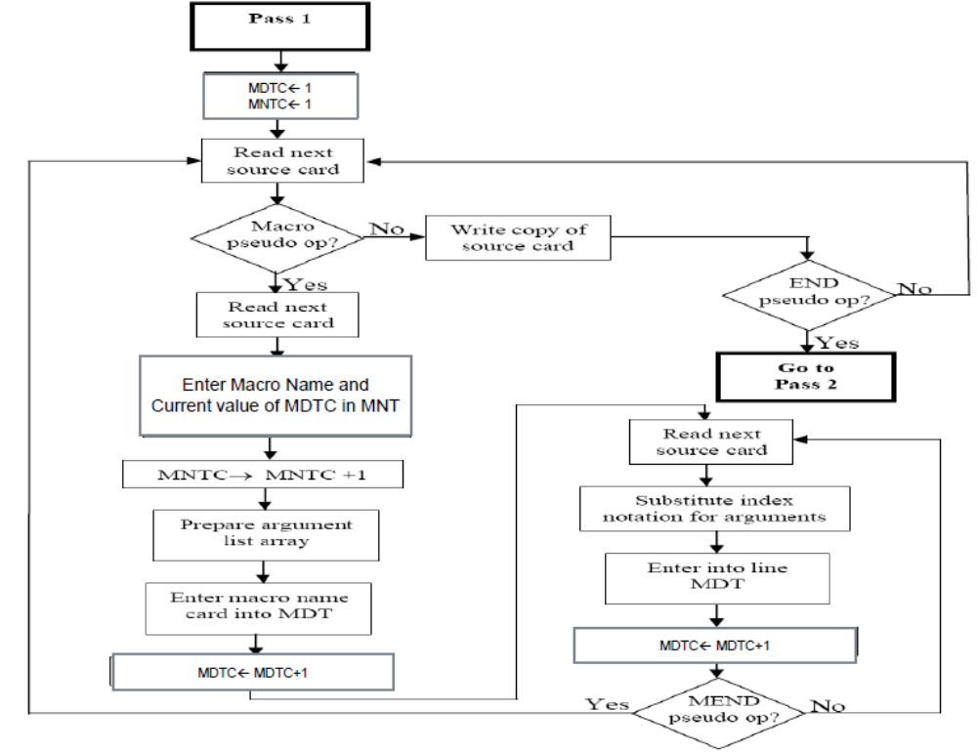

Pass-1 of Two Pass Macro Processor
Pass-1 Flowchart

Slide 32
Before Processing: Input.asm and Tables
MNT
//Source Code with Macro definition & call
MACRO
ADDS &arg1,&arg2
L 1, &arg1
A 1, &arg2
MEND
PROG START 0
BALR 15,0
USING *,15
ADDS DATA1, DATA2
ST 4,1
DATA1 DC F’3’
DATA2 DC F’4’
END
Index | Macro name | MDT index
Macro Definition
MDT
MDT Index | Macro Definition
ALA
Index | Argument

Slide 33
After Processing: output.txt and Tables
MNT
//output without Macro definition but with macro call
PROG START 0
BALR 15,0
USING *,15
ADDS DATA1, DATA2
ST 4,1
DATA1 DC F’3’
DATA2 DC F’4’
END
Index | Macro name | MDT index
1 | ADDS | 1
MDT
MDT Index | Macro Definition
1 | ADDS &arg1, &arg2
2 | L 1, #1
3 | A 1, #2
4 | MEND
ALA
Index | Formal Argument
1 | &arg1
2 | &arg2

Slide 34
Pass-2 before processing: output.txt and Tables
MNT
//output without Macro definition but with macro call
PROG START 0
BALR 15,0
USING *,15
ADDS DATA1, DATA2
ST 4,1
DATA1 DC F’3’
DATA2 DC F’4’
END
Index | Macro name | MDT index
1 | ADDS | 1
MDT
MDT Index | Macro Definition
1 | ADDS &arg1, &arg2
2 | L 1, #1
3 | A 1, #2
4 | MEND
ALA
Index | Argument
1 | &arg1
2 | &arg2

Slide 35
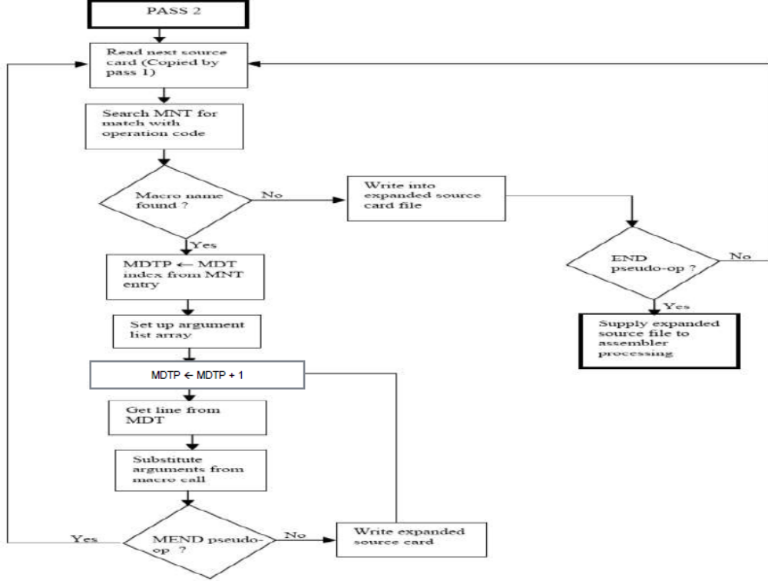
Pass-2 of Two Pass Macro Processor
Pass-2 Flowchart
Read from MDT

Slide 36
Pass-2 after processing: output.txt and Tables
MNT
//output without Macro definition and call
PROG START 0
BALR 15,0
USING *,15
L 1, DATA1
A 1,DATA2
ST 4,1
DATA1 DC F’3’
DATA2 DC F’4’
END
Index | Macro name | MDT index
1 | ADDS | 1
MDT
MDT Index | Macro Definition
1 | ADDS &arg1, &arg2
2 | L 1, #1
3 | A 1, #2
4 | MEND
ALA
Index | Formal Argument | Actual Argument
1 | &arg1 | DATA1
2 | &arg2 | DATA2

Slide 37
Example-2
MNT
Index | Macro name | MDT index
1 | ADDS | 1
2 | TEST | 5
//Source Code with Macro definition & call
MACRO
ADDS &arg1,&arg2
L 1, &arg1
A 1, &arg2
MEND
MACRO
&L TEST &CNT, &A2
&L SR 4,4
C 4,&CNT
A 4,&A2
MEND
PROG START 0
BALR 15,0
USING *,15
Lable TEST 3, D1
AR 4,4
ADDS DATA1, DATA2
ST 4,1
DATA1 DC F’3’
DATA2 DC F’4’
D1 DC F’9’
END
MDT
MDT Index | Macro Definition
1 | ADDS &arg1,&arg2
2 | L 1,#1
3 | A 1,#2
4 | MEND
5 | &L TEST &CNT,&A2
6 | #3 SR 4,4
7 | C 4,#4
8 | A 4, #5
9 | MEND
10
//o/p
PROG START 0
Index | Argument
1 | &arg1
2 | &arg2
3 | &L
4 | &CNT
5 | &A2
ALA

Slide 38
Example-2: Pass-1 o/p
MNT
Index | Macro name | MDT index
1 | ADDS | 1
2 | TEST | 5
//Source Code with Macro call
PROG START 0
BALR 15,0
USING *,15
TEST 3, D1
AR 4,4
ADDS DATA1, DATA2
ST 4,1
DATA1 DC F’3’
DATA2 DC F’4’
D1 DC F’9’
END
MDT
MDT Index | Macro Definition
1 | ADDS &ARG1, &ARG2
2 | L 1, #0
3 | A 1, #1
4 | MEND
5 | &L TEST &CNT, &A2
6 | #2 SR 4,4
7 | C 4,#3
8 | A 4,#4
9 | MEND
10
Index | Argument
0 | &arg1
1 | &arg2
2 | &L
3 | &CNT
4 | &A2
ALA

Slide 39
Theory Questions
Draw and explain flowchart of pass-1 of two pass macro processor?
Draw and explain flowchart of pass-2 of two pass macro processor
What are the data structures used in Macro processor? Explain them with example.
What are the types of arguments type for macro processor? Explain them with example.
What is macro?

Slide 40
MNT
Index | Macro name | MDT index
Source Code
MACRO
DEFINE &SUB
MACRO
&SUB &Y
CNOP 0,4
BAL 1,*+8
DC A(&Y)
L 15,=V(&SUB)
BALR 14,15
MEND
MEND
PROG START
SR 1,1
DEFINE COS
AR 1,4
COS AR
L 1,X
END
MDT
MNTC=1
MDTC=1
MDI=“OFF”
MDLC=0
MDTP=
MDT Index | Macro Definition
Index | Argument
ALA

Slide 41
Single pass macro processor
Link to ppt

Slide 42
Summary of last lecture
Macro Definition
Macro Syntax-> definition & call
Macro Arguments/Parameters Type
Facilities by Macro
  Macro Calls within Macros (Nested Macro Calls)
  Macro instruction defining Macros (Macro Definition within macro)
  Conditional Macro Expansion (AIF & AGO)
  Expansion time variables (LCL, GBL, SET)
  Expansion time Loops

